Slide 1




PRESENTATION
CELLULAR AUTOMATA
Hardika Nehate (16010420112), Prathik Chadaga (16010420113), Preeti Shah (16010420), Soham Bhoir (16010420117).

Slide 2
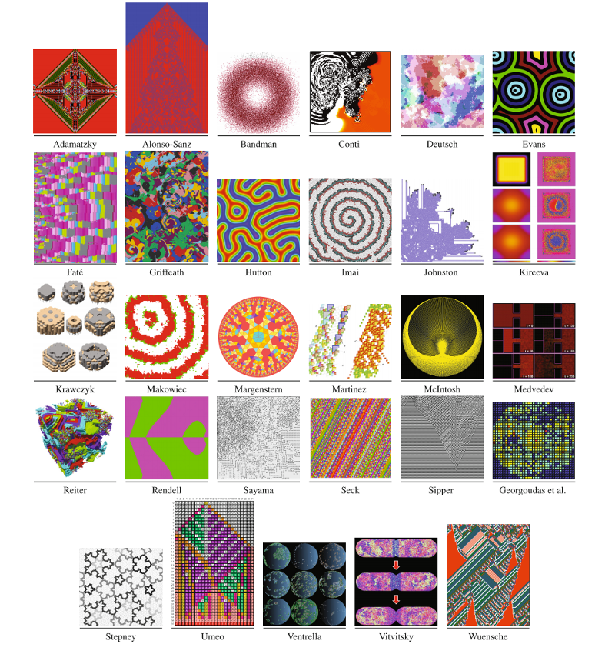
What are
Cellular Automata
A CA is an array of identically programmed automata or cells, which interact with one another and have definite state.
ANOTHER PESPECTIVE
It is a Finite State Machine with one transition function for all the cells, the transition function changes the current state of cell depending upon previous state for that cell and its neighbours.

Slide 3
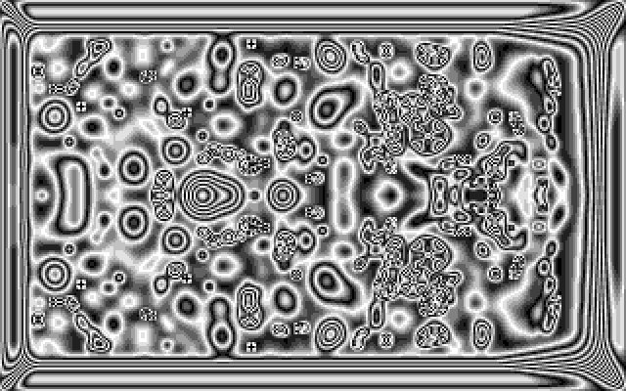
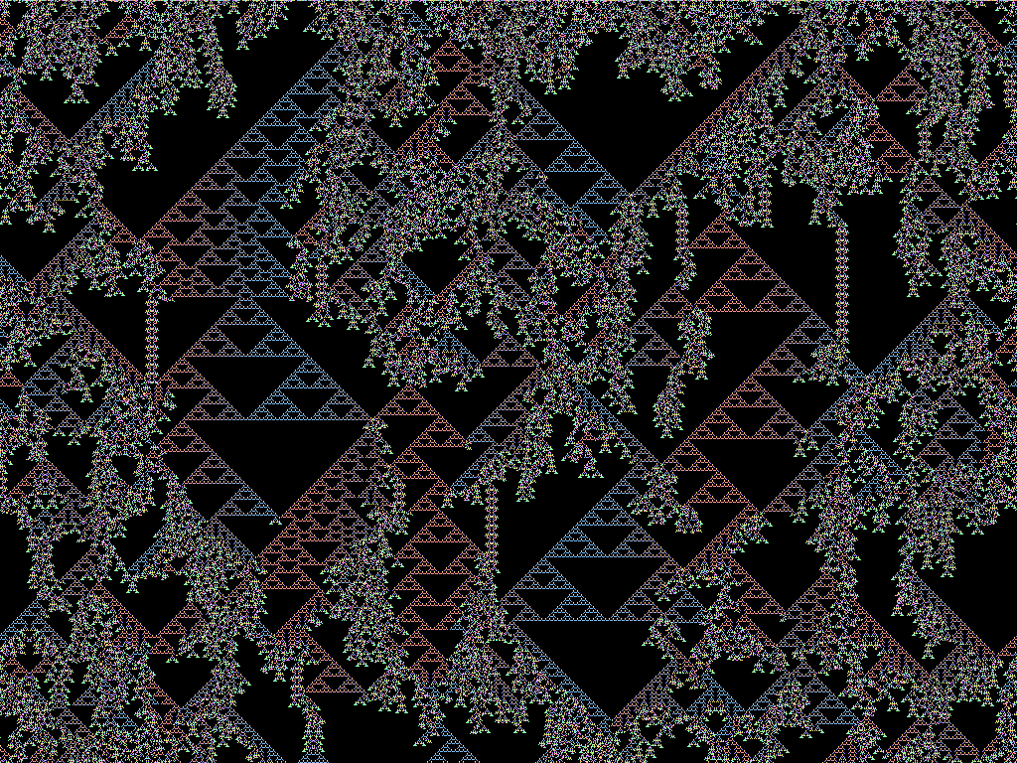
More about CA
CA are discrete dynamic system
They are called as discrete because they operate in a finite space and time with properties that have only a finite number of states
CA are said to be dynamic because they exihit dynamic behaviour.
Basic Idea: Simulate complex structures by interaction of cells

Slide 4

STUDIO SHODWE
Elementary CA
1.) Grid.
Or 1D CA
2.) States.
One dimensional Cellular Automata is the simplest level of cellular automata , known as elementary cellular automata
3.) Neighborhood.
The following are the parts of a elementary cellular automata

Slide 5
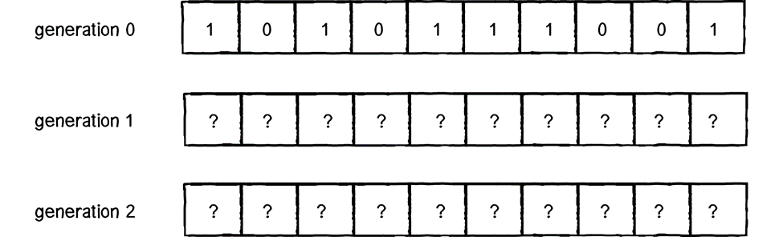
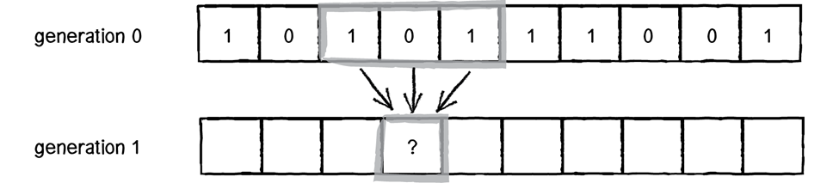
An elementary CA living over a period of time is called a generation.
Edges remain constant and always leave their state value constant (0 or 1).
For every generation there will be an outcome.

Slide 6
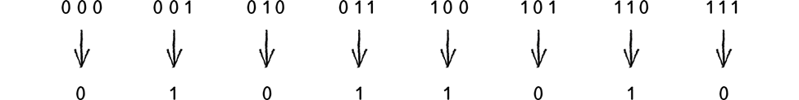
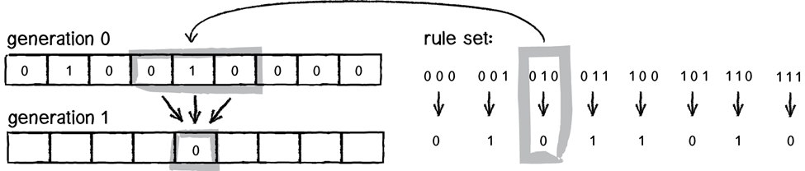
Consider a 3 bit input
For this example the outcomes will be based on the Wolfram ruleset 90.
Choose the middle state

Slide 7
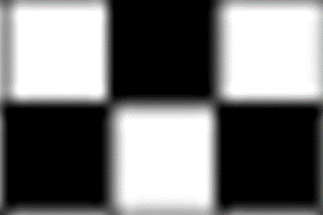
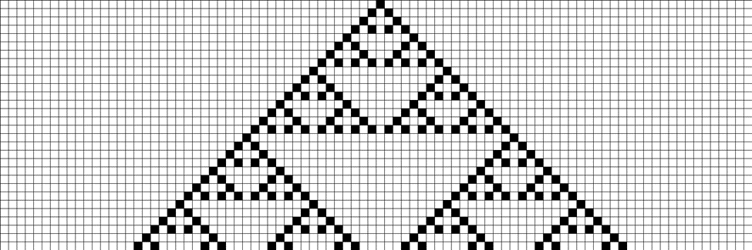
Considering 1 as black color and 0 as white the following set can be obtained,
Similarly, if several generations are stacked together the following pattern will be formed,
Sierpiński triangle

Slide 8
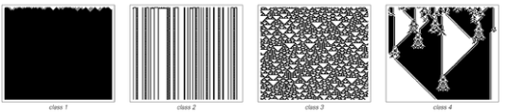
Classification of CA
Wolfram's classification was the first attempt to classify the rules themselves. In order of complexity the classes are:
Class 1:the behavior is very simple, and almost all initial conditions lead to exactly the same uniform final state.
Class 2: , there are many different possible final states, but all of them consist just of a certain set of simple structures that either remain the same forever or repeat every few steps.
Class 3: the behavior is more complicated, and seems in many respects random, although triangles and other small-scale structures are essentially always at some level
Class 4: Class 4 systems are once again somewhat intermediate between class 2 and class 3. Long-range communication of information is in principle possible, but it does not always occur

Slide 9
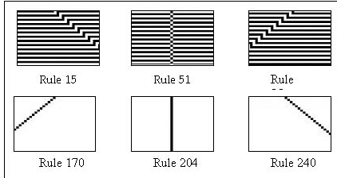
Reversible
Cellular Automata
A cellular automaton is reversible (also called invertible or microscopically reversible), if its global map is invertible, i.e., for every possible state of the cellular automaton the global map specifies one and only one successor. If a cellular automaton is invertible, it therefore is deterministic in both directions of time. The rule that makes a cellular automaton go backward is called the inverse rule opposite to the direct rule that runs the cellular automaton forward direction of time. In general, the inverse rule is different from the direct rule except for trivial cases shown in the following figure.

Slide 10
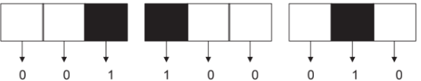
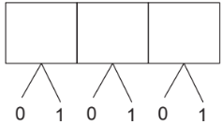
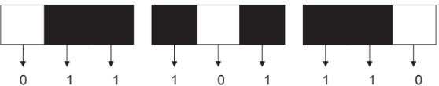
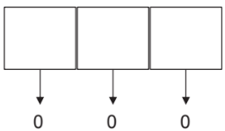
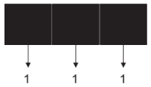
Totalistic Cellular Automata
The total value will be 1 when one of the three cells has value 1 and the other two have value 0. This can happen in 3C1 = 3 ways.
A totalistic cellular automaton is a cellular automata in which the rules depend only on the total (or equivalently, the average) of the values of the cells in a neighborhood.
Let us consider the case of a three cell neighbourhood (as described in the earlier section) where each cell has a value of 0 or 1.
Similarly for a total value of 2, two out of the three cells must have value 1 which can happen in 3C2 = 3 ways
Note that each neighbourhood of three cells will have a total value of 0 when all the three cells have value 0 as shown.
Finally the total value of 3 occurs when all cells have value 1 and this can occur in only 1 way.

Slide 11
2DCA:John Conway's Game of life
Each generation switches cells on or off, depending on the state of the cells that surround it.
In Life, eight cells surround a given cell. All eight of these cells are checked to see if they are on. On cells are counted, and this count is used to determine what will happen to the current cell. Based on the count, the rules defining Life are as follows:
Death: If the count is < 2 or > 3, the current cell is switched off.
Survival: If the count = 2 or the count = 3 and the current cell is on, it is left unchanged.
Birth: If the current cell is off and the count = 3, it is switched on.
John Conway's Game of Life (also known simply as Life) is a two-dimensional, totalistic CA that introduces more complexity than an elementary CA, since each cell in the grid has a bigger neighborhood. It is a "universal" (or computation-universal) CA since it can effectively emulate any CA, Turing machine or other system that can be translated into a system known to be universalInstead of a one-dimensional line of cells, this two-dimensional CA consists of a matrix of cells.

Slide 12
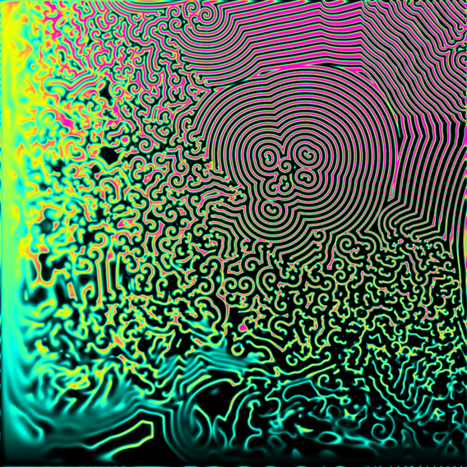
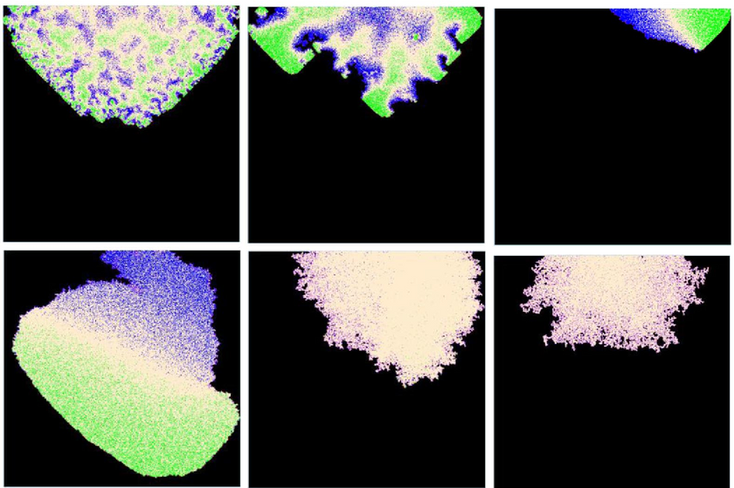
Application of
Cellular Automata
In Chemistry
To simulate complex chemical and biochemical reaction which mainly resembles like a wave pattern. Eg simulation of Belousov-Zhabotinsky reaction
In Physical Systems
Description of recrystallization in certain types of metals and alloys. They describe dendrites during crystallization. Via this We can predict how a metal can be corroded by simulating the spread pattern. Also crack propagation within metals.

Slide 13
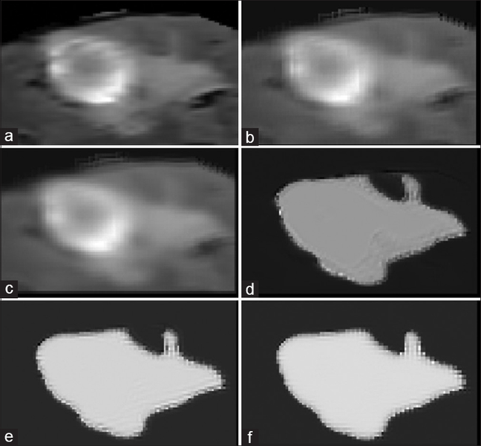
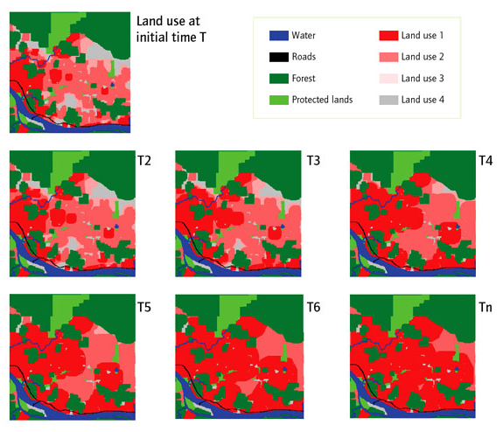
In Medicines
the flow of blood through vessels, their interactions with vessel calls, simulation and prediction of pressure within aneurysm, etc. Eg Used in Brain tumor segmentation
In Geography
CA is used in geographical information sciences to model urban dynamics or basically any physical and complex pattern on land, sea, ice. When using models units can be used (similar to CA cells) to convey earthquake patterns, water flow using precipitation levels, ground-water flow to calculate erosion etc

Slide 14

THANK YOU
Hardika Nehate (16010420112), Prathik Chadaga (16010420113), Preeti Shah (16010420114), Soham Bhoir (16010420117).

